Slide 1
Blue green deployment using ALB

Slide 2
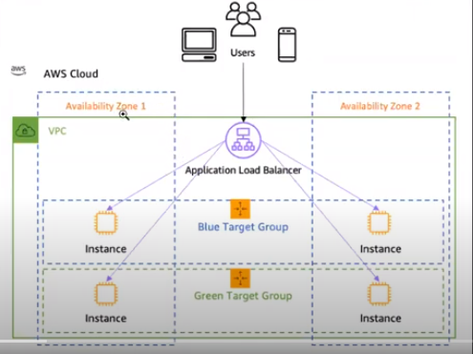

Slide 3
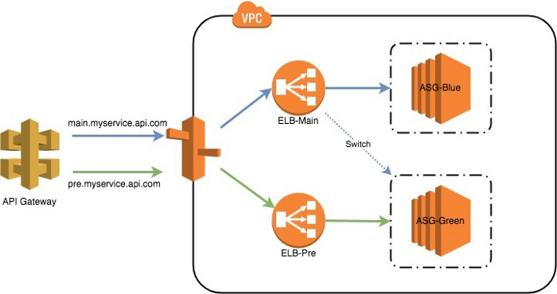
Blue/Green deployment with Classic Load Balancer

Slide 4
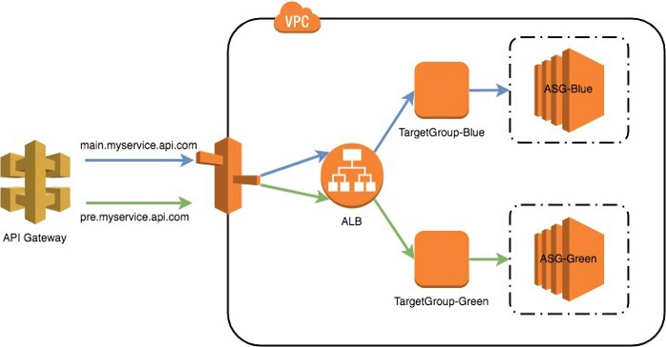
Blue/Green deployment using ALB

Slide 5
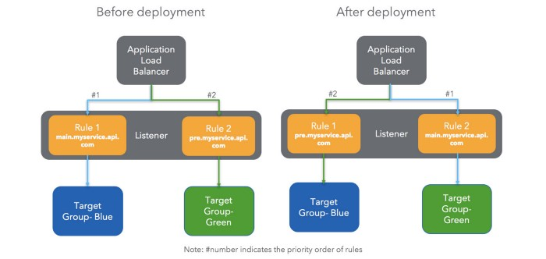
Cut-over

